Slide 1

Graph Element Networks:
adaptive structured computation and memory
Ferran Alet, Adarsh K. Jeewajee, Maria Bauza,
Alberto Rodriguez, Tomás Lozano-Pérez, Leslie Pack Kaelbling

Slide 3
Convolutional Neural Networks are a useful inductive bias because they

Slide 4
Convolutional Neural Networks are a useful inductive bias because they
exploit a structural property
Locality & translation invariance

Slide 5
Convolutional Neural Networks are a useful inductive bias because they
exploit a structural property
that is satisfied in a broad set of tasks.
Locality & translation invariance
Computer Vision

Slide 6
Graph Neural Networks are a useful inductive bias because they

Slide 7
Graph Neural Networks are a useful inductive bias because they
exploit a structural property
Entities exist & permutation invariant

Slide 8
Graph Neural Networks are a useful inductive bias because they
exploit a structural property
that is satisfied in a broad set of tasks.
Entities exist & permutation invariant
Model entities and relations

Slide 9
Graph Element Networks are a useful inductive bias because they

Slide 10
Graph Element Networks are a useful inductive bias because they
exploit a structural property
Functions are locally linear

Slide 11
Graph Element Networks are a useful inductive bias because they
exploit a structural property
that is satisfied in a broad set of tasks.
Functions are locally linear
Function to function maps
Notes:
1’30’’

Slide 12

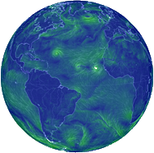



Spatial Function Transformations
Images from earth.nullschool.net
Metric space (x)
Input function
Output function
Humidity and wind today
Rain tomorrow

Slide 13
We map functions to functions
,
f₁ g₁
,
f₂ g₂
…
,
f_{n} g_{n}
f
g
Dataset

Slide 14






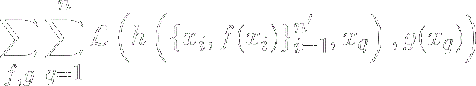
We map functions to functions
Jan 1
Jan 2
June 11
,
,
…
Input function: humidity & wind today
Query
,
f
g
Dataset
Notes:
4’20’’

Slide 15
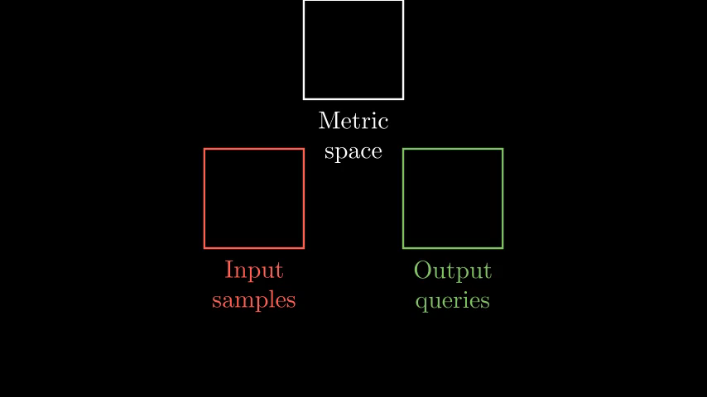

Slide 16
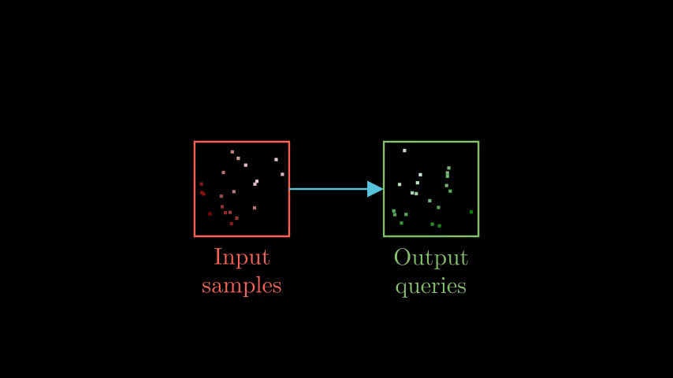

Slide 17
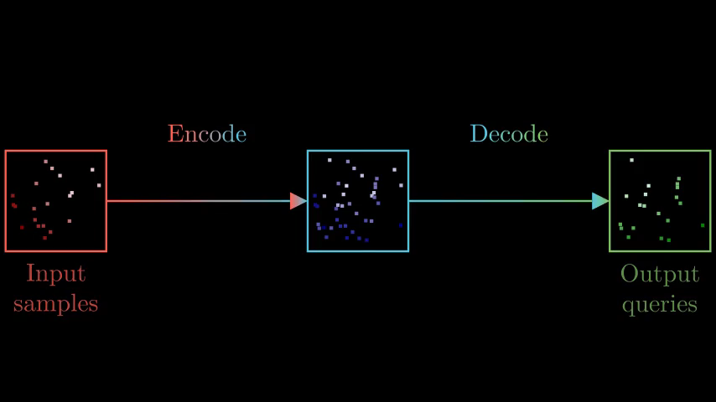

Slide 18
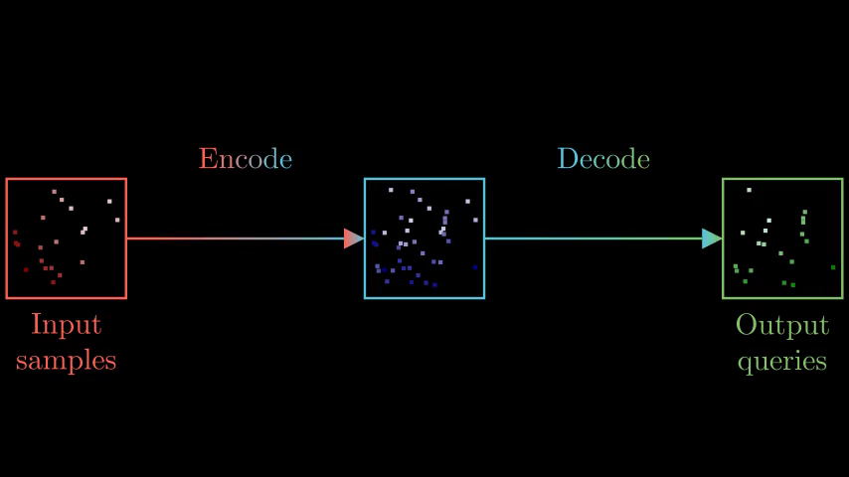

Slide 19
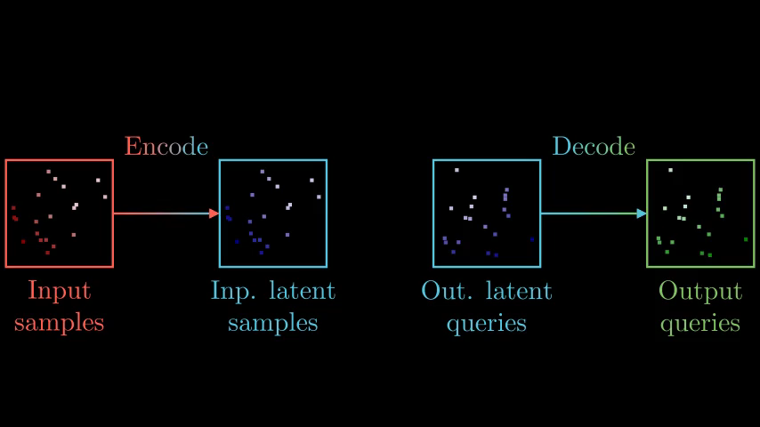

Slide 20
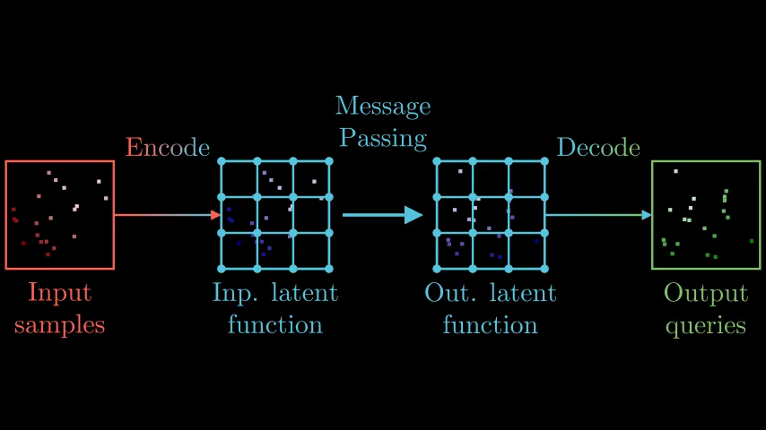
Notes:
6’30’’

Slide 21
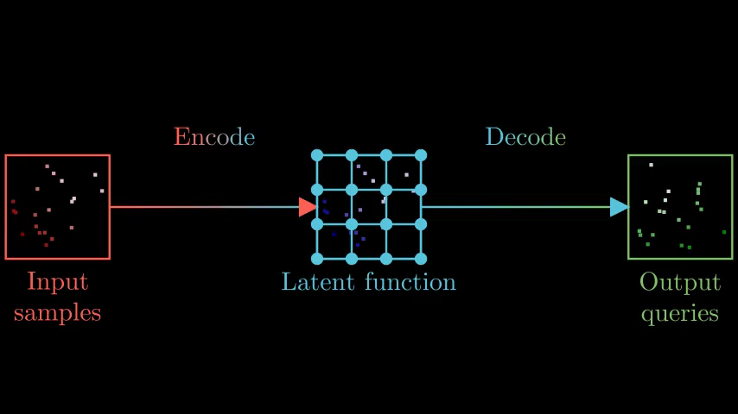

Slide 22
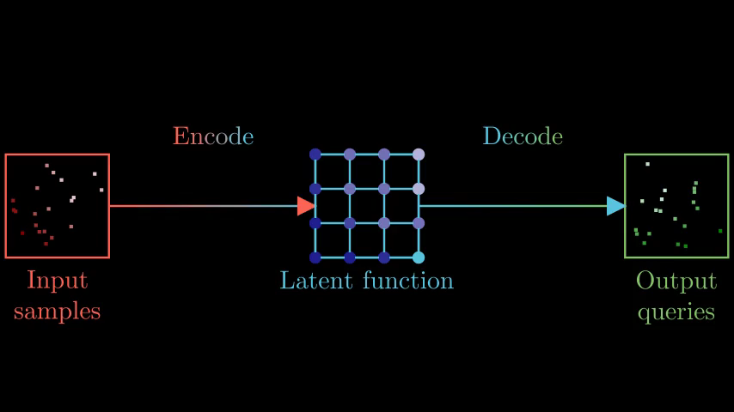

Slide 23
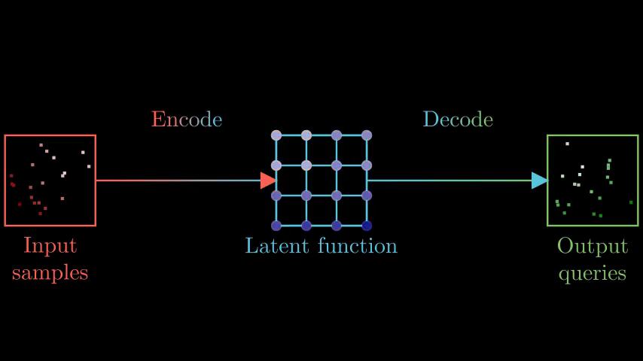

Slide 24
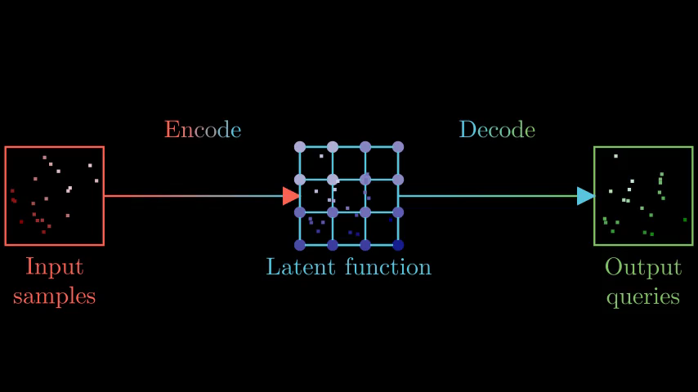

Slide 25
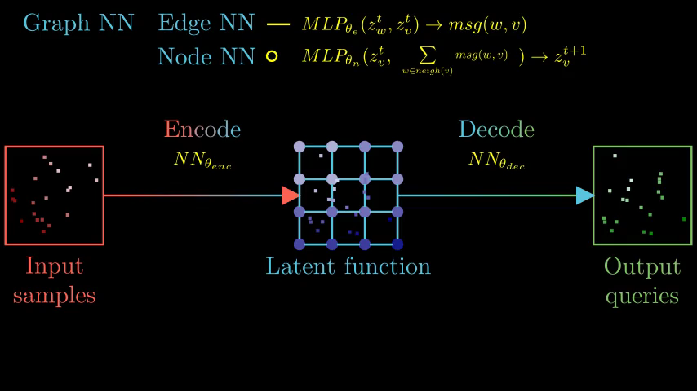

Slide 26
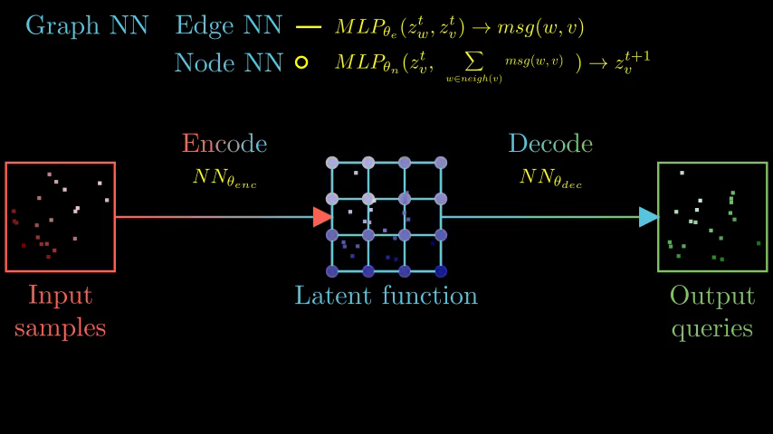

Slide 27

Notes:
9’20’’-10’

Slide 28

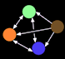


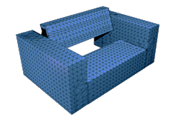
Most Graph Neural Nets have nodes tied to entities
Objects (Battaglia et al., Chang et al)
Particles (Mrowca et al., Wu et al.)
Joints (Wang*,Liao* et al.)
Geometric Deep Learning (Bronstein et al.)
Meshes (Monti et al., Smith et al.)

Slide 29
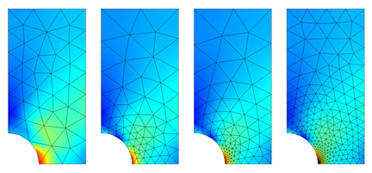
Graph Element Networks are inspired by Finite Element Methods
Widely used in engineering
Decompose space in small regions
Notes:
10’50’’-11’30’’

Slide 30
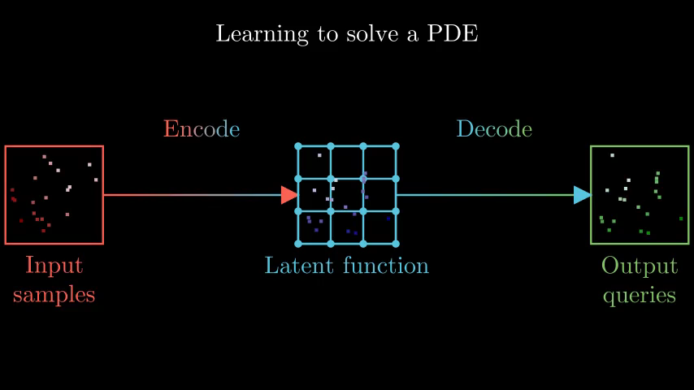
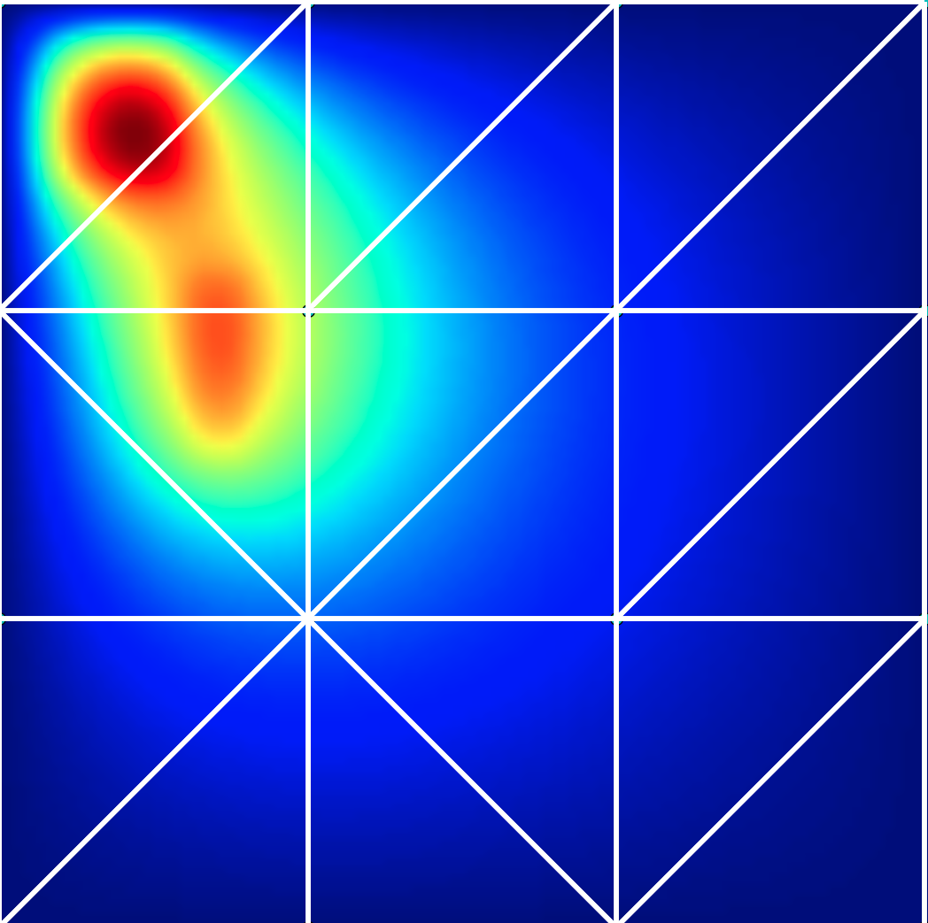

Slide 31
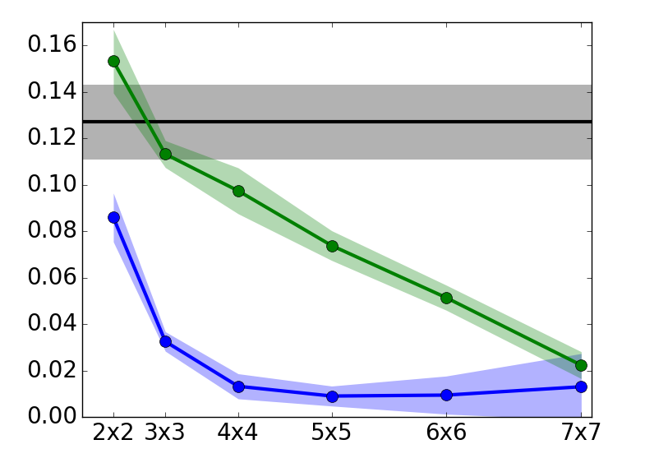




GENs have flexible computation time
Baseline
Mean
Squared
Error
Graph Element Networks
GENs with
optimized meshes

Slide 32
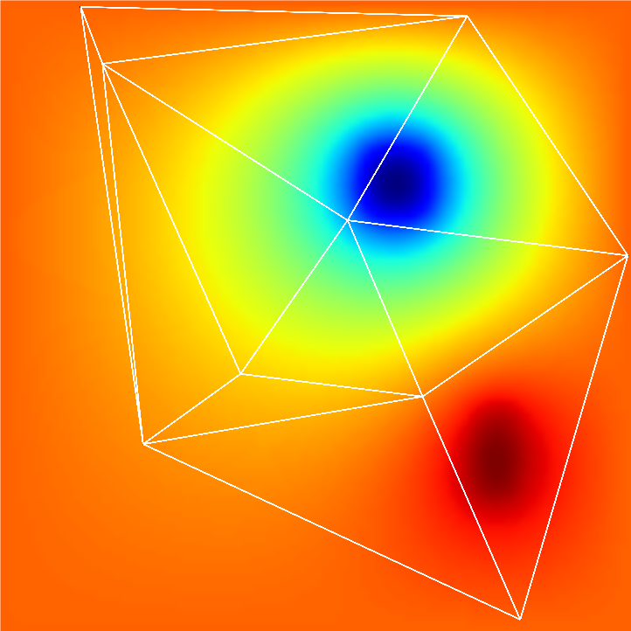
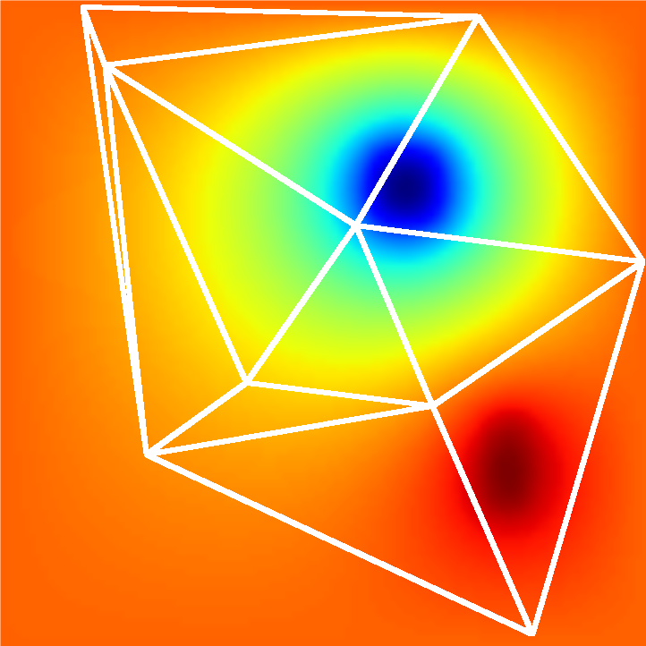
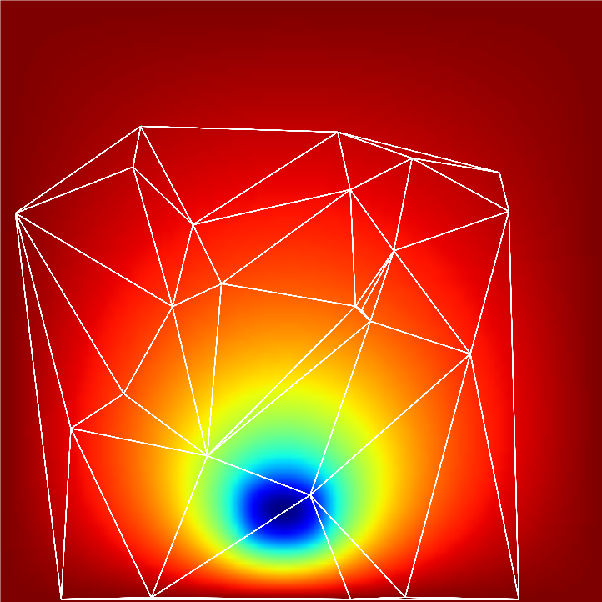
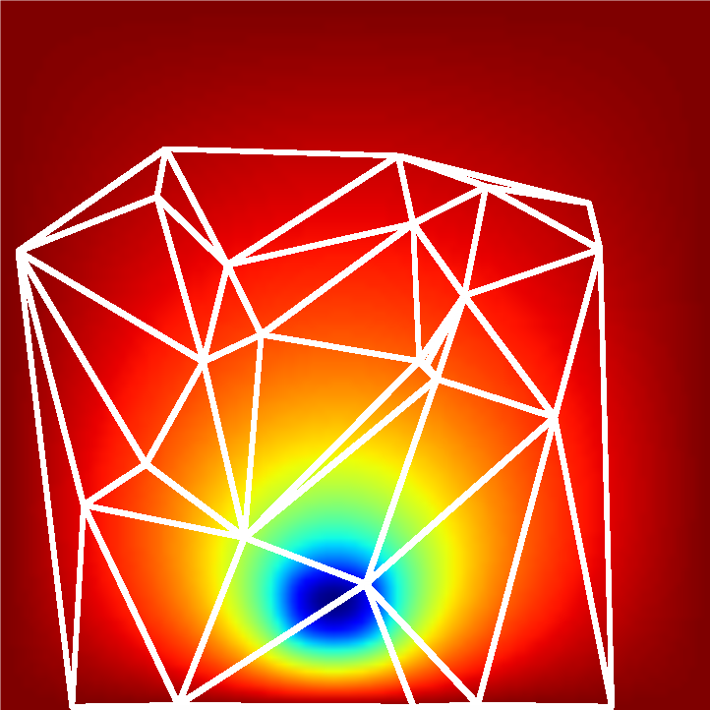
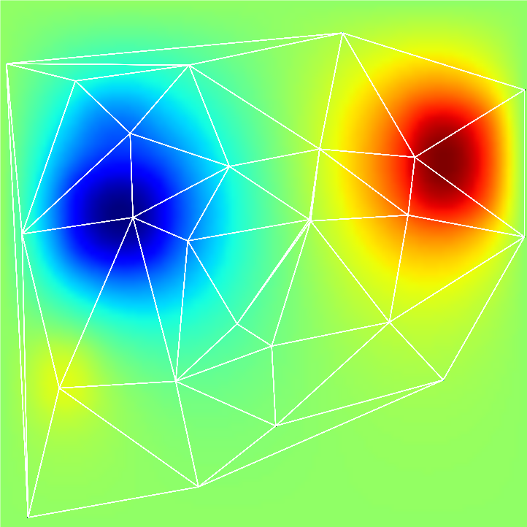
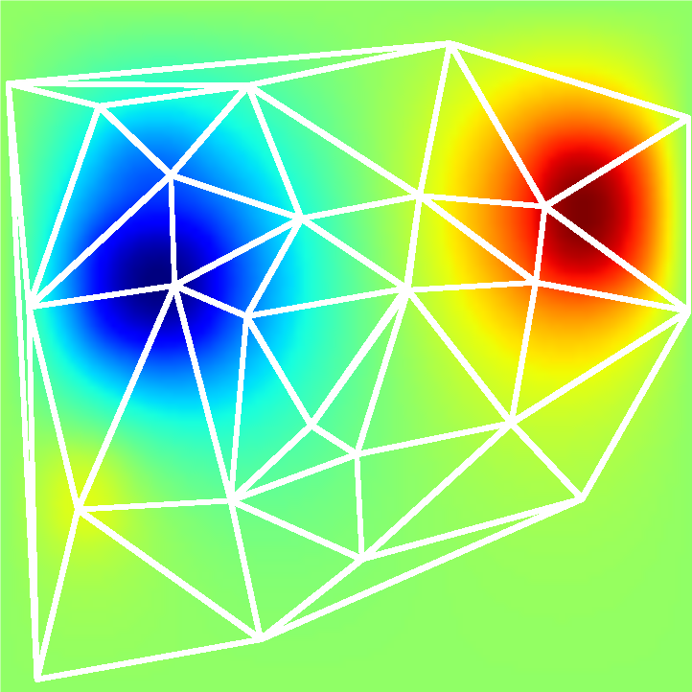
Optimized meshes focus computation where it matters
3x3
4x4
5x5

Slide 33
Optimizing meshes greatly improves performance
Baseline
Mean
Squared
Error
Graph Element Networks
GENs with
optimized meshes
Notes:
12’05-13’

Slide 34
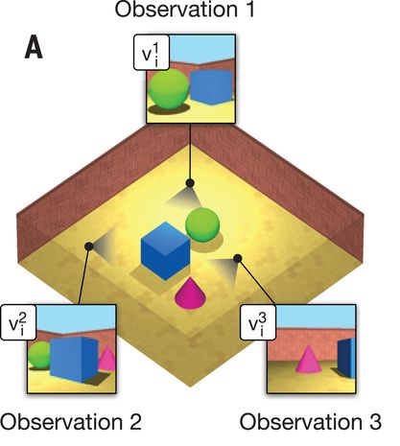
Neural Scene Representation (Eslami et al. 2018)

Slide 35
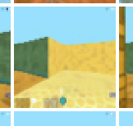
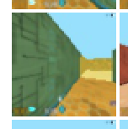
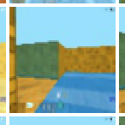
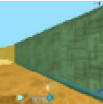
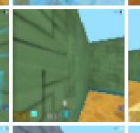

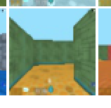
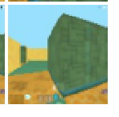
Contrastive Coding framework
pose 1
Model
pose 2
pose n
query pose
inputs
candidates

Slide 36
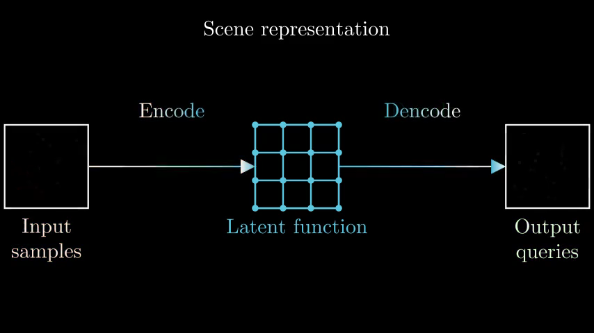

Slide 37
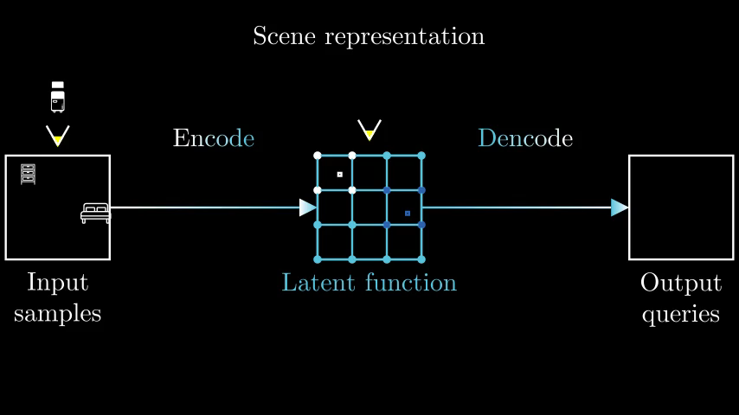

Slide 38
Training on small mazes, testing on big ones
Train
One maze from original dataset
Test

Slide 39
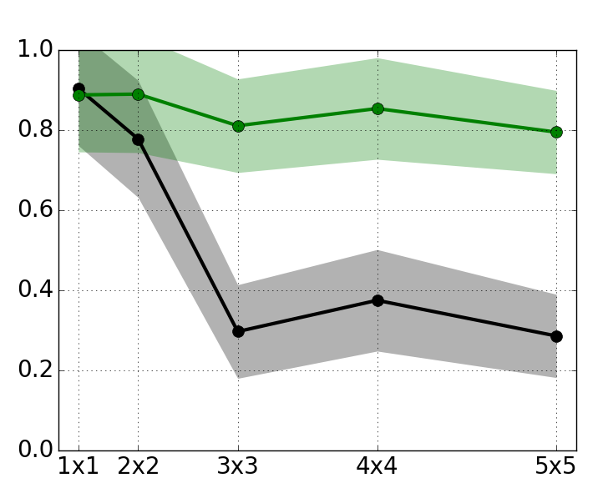
Generalize to more mazes by expanding the mesh
Graph Element Networks
Accuracy
Baseline
number of mazes
Notes:
15’30’’

Slide 40
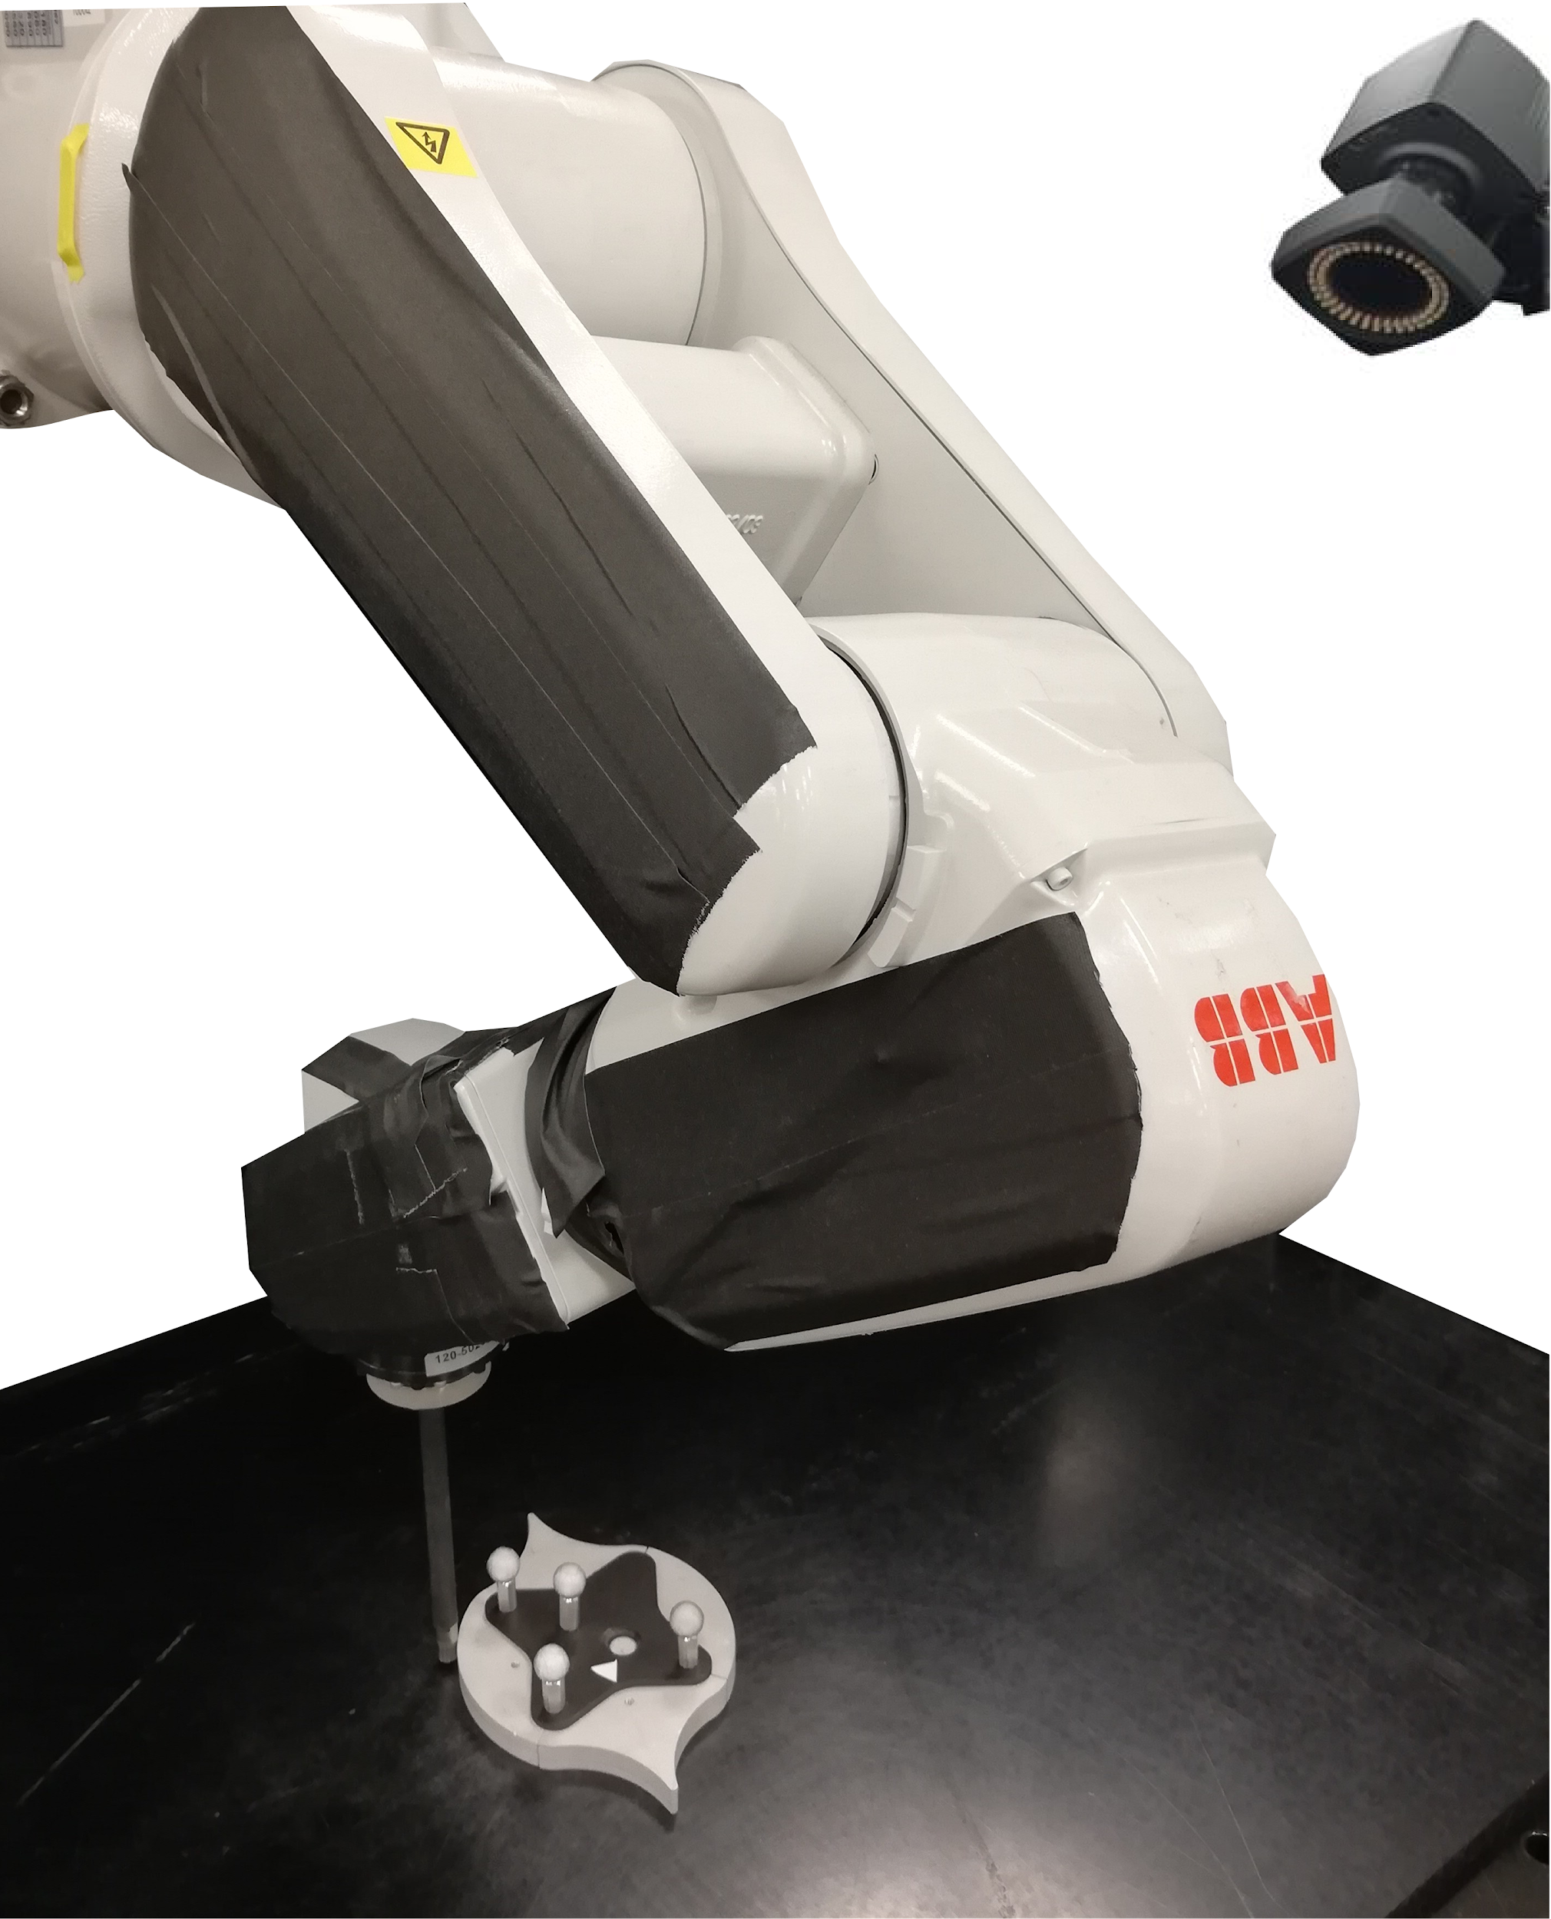
Function to function maps have varied applications
Solving PDEs
Robotics
Scene representation

Slide 41
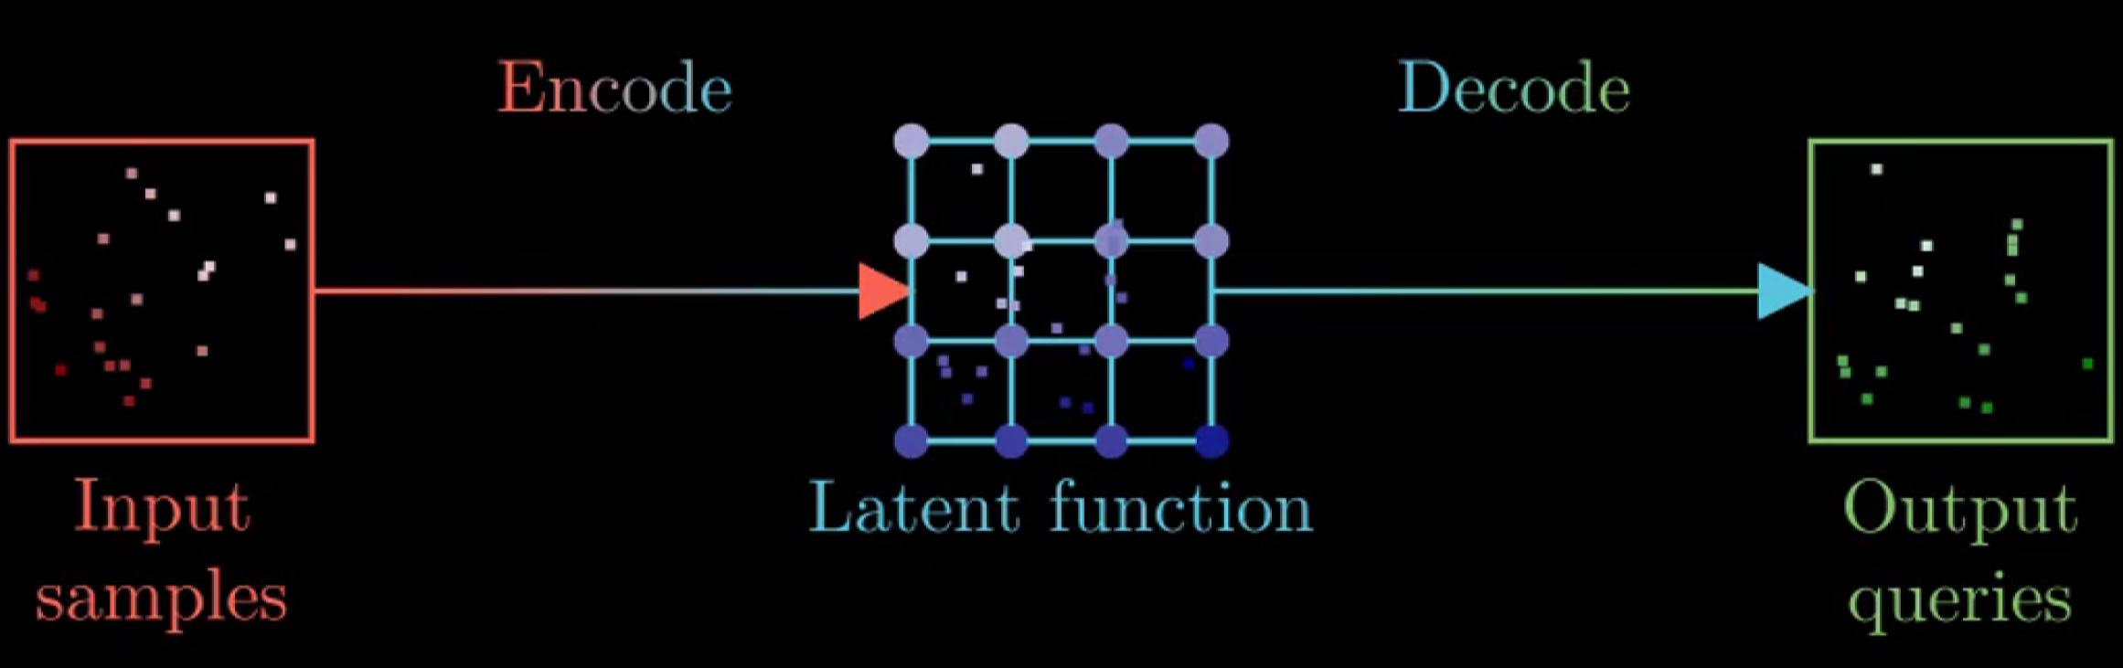
Function to function maps have varied applications

Slide 42
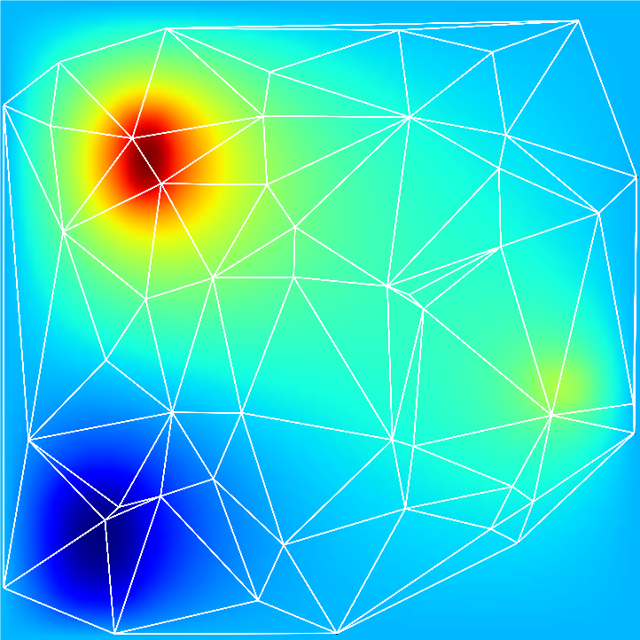
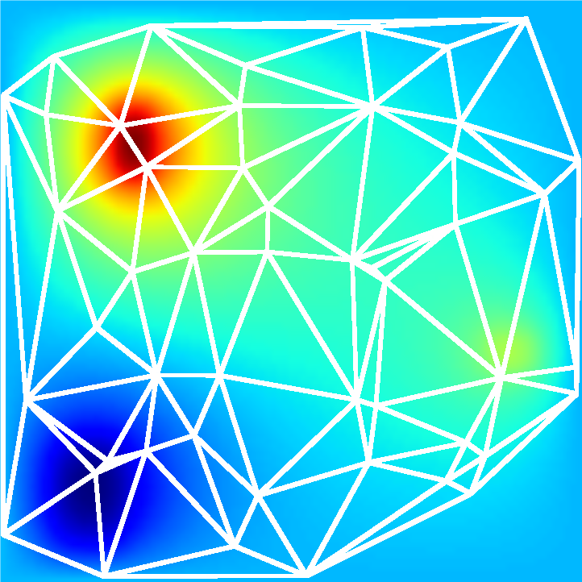
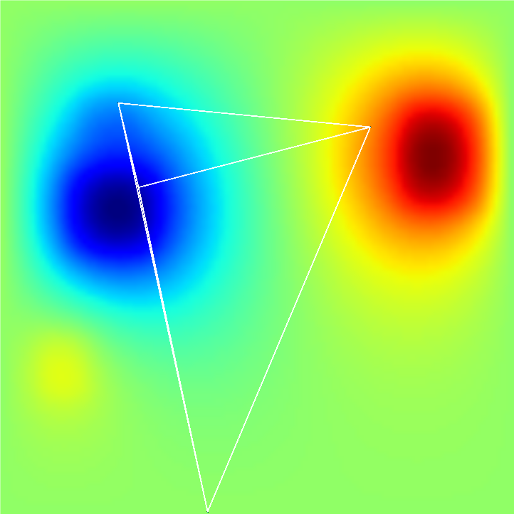
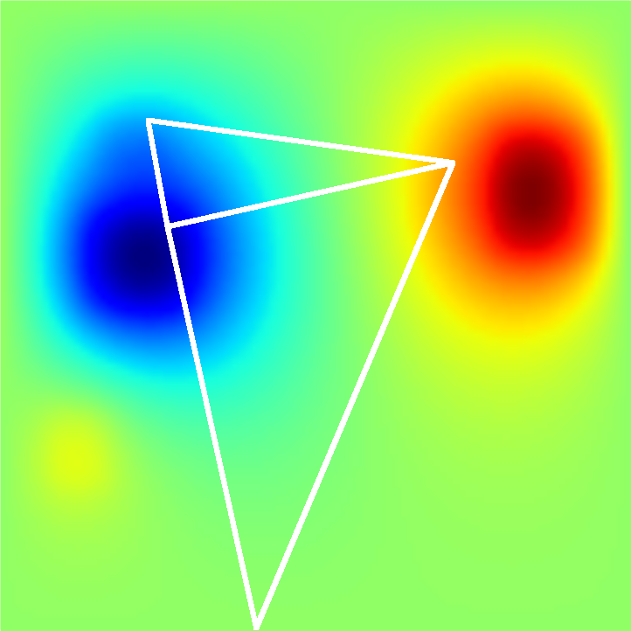
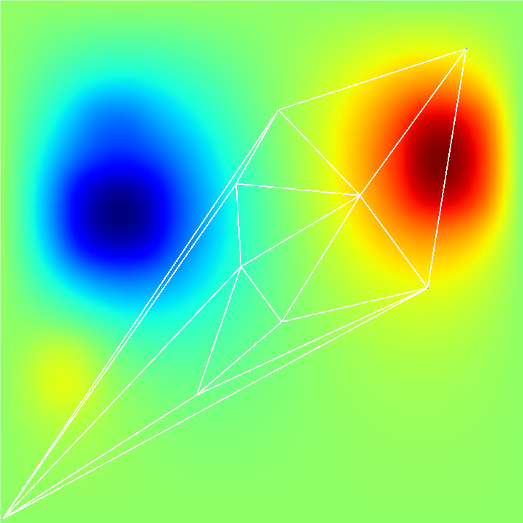

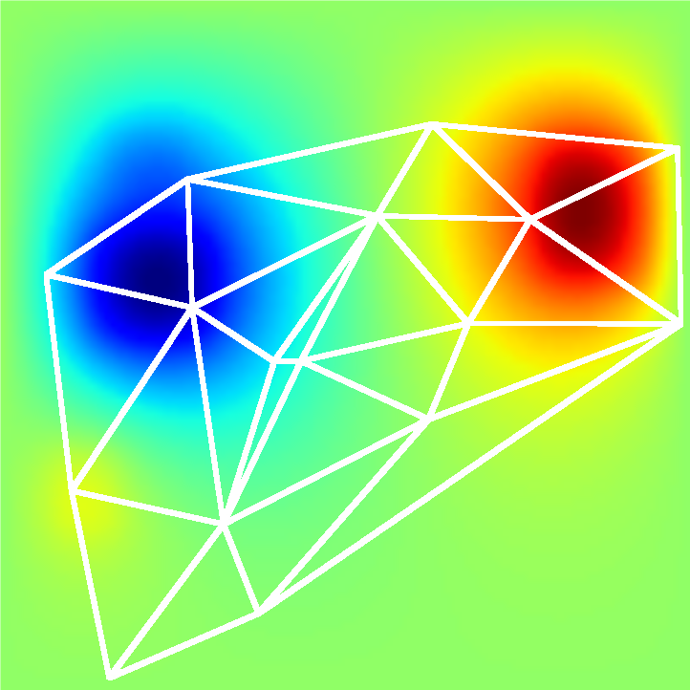

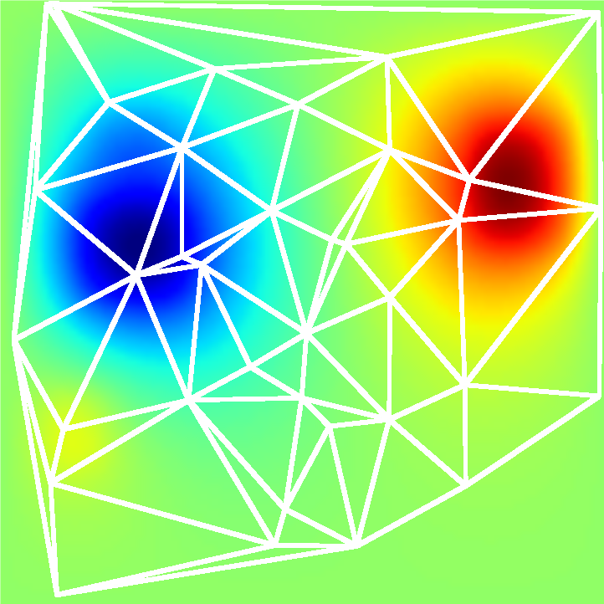

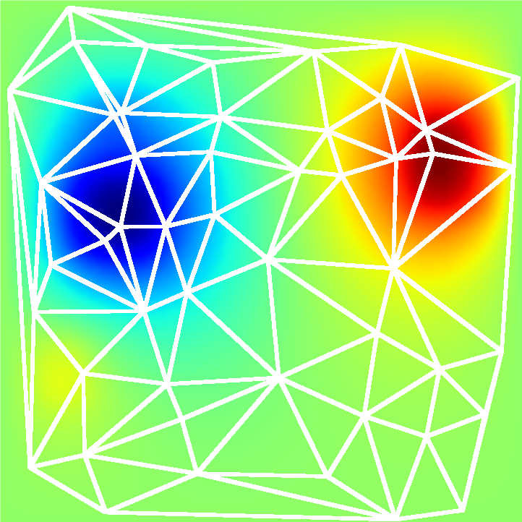
We use GNNs as adaptive computational substrate
Focus on harder regions
Trade between compute and accuracy
3x3
5x5
7x7
2x2
3x3
4x4
Expand with space size
5x5
6x6
7x7

Slide 43





Graph Element Networks:
adaptive structured computation and memory
Ferran Alet Adarsh K. Jeewajee Maria Bauza
Alberto Rodriguez Tomás Lozano-Pérez Leslie Pack Kaelbling
alet-etal.com
Poster #16

